Slide 1

AWS Solution Architect: Course-End Project
This Photo by Unknown Author is licensed under CC BY-SA

Slide 2
Write Up
Steps to create data in a Kinesis stream that can be copied to the DynamoDB database
Creating an AWS Kinesis Data Streams
Creating an AWS Lambda Function
Creating an AWS DynamoDB Database
Creating Lambdaexcution role + kinesis permissions
Adding Kinesis trigger in Lambda function for integration and to read data from kinesis data stream
Adding policy write data into my DynamoDB tables in my lambda function role
Using Google Colab to generate data stream code and sending to my Kinesis CloudDatatStream
Fetching data from automobile.csv and converting to json format and sending to my Kinesis CloudDataStream
Monitoring data reached to my Kinesis CloudDataStream
Fetching Kinesis CloudDataStream data via my Lambda function code and storing the same data in my DynamoDB automobiles table
Using CloudWatch Lambda logs to Monitor data reached to my CloudDataStream
Perform Scan Operation
Output Screenshot

Slide 3
Source Code
⦁ Kinesis CloudDataStream generater code.
⦁ Lambda function datareadfromkinesis code.
Code attached -

Slide 4
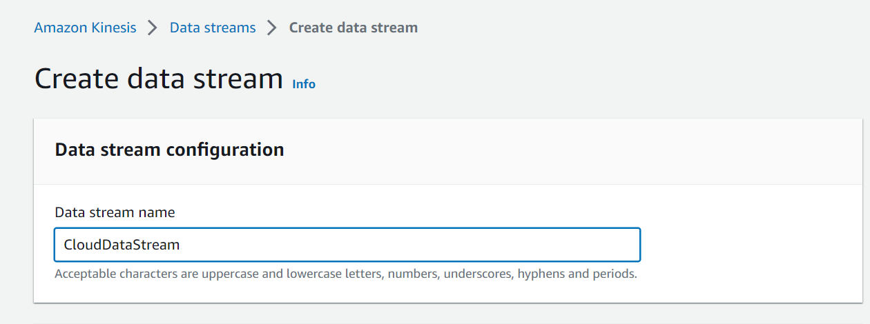
Creating an AWS Kinesis Data Stream

Slide 5
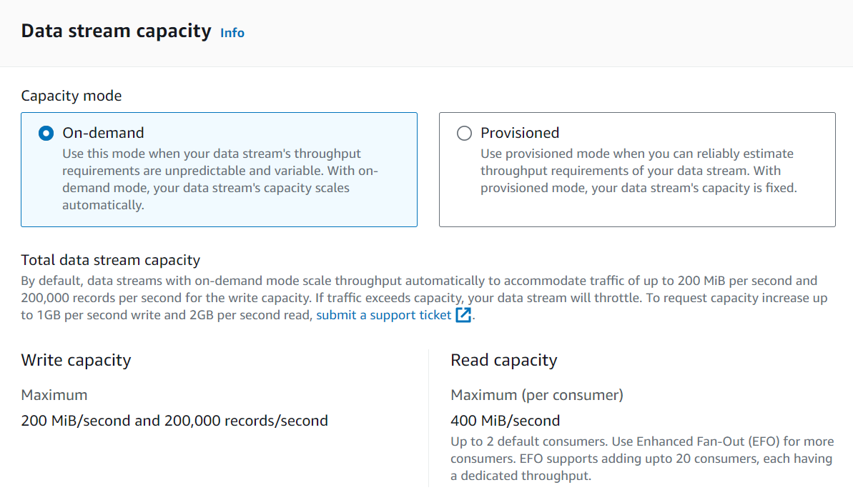
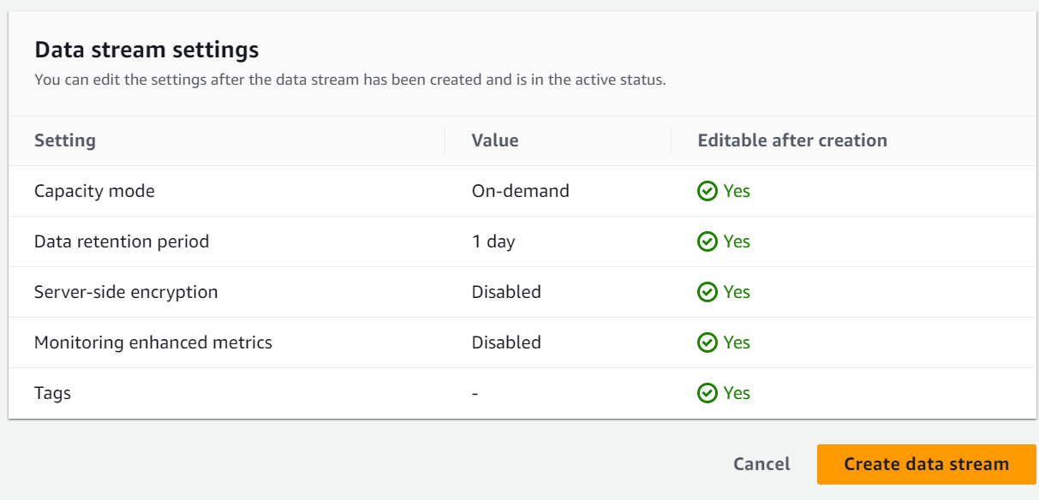

Slide 6
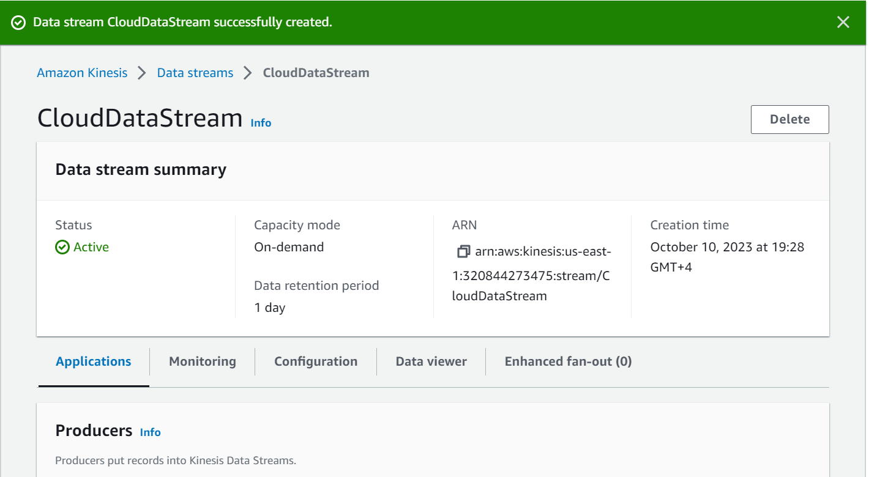
Kinesis Data Streams Created

Slide 7
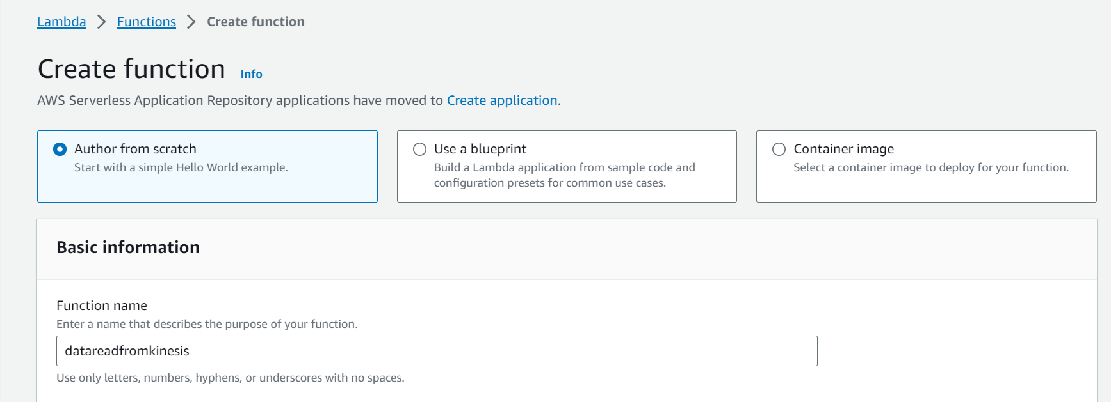
Creating Lambda Function

Slide 8
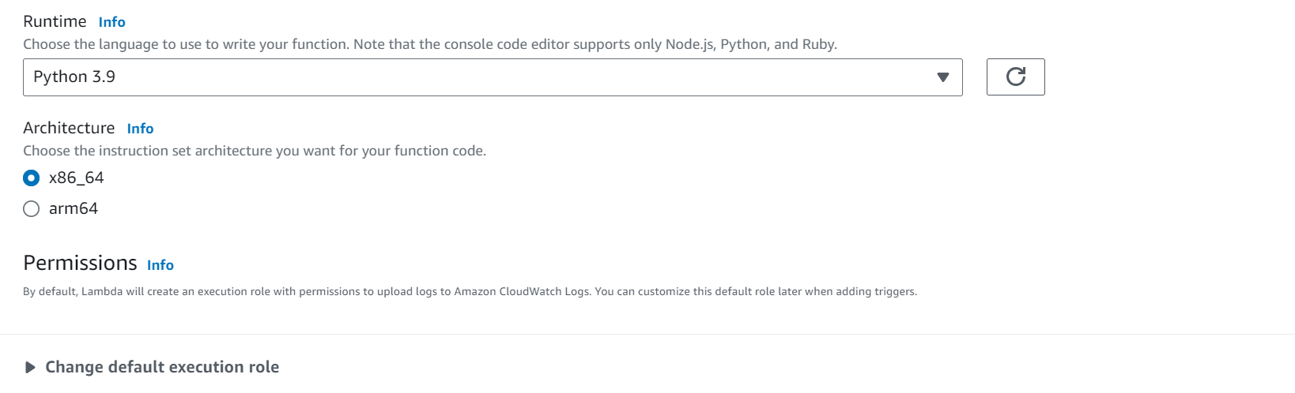
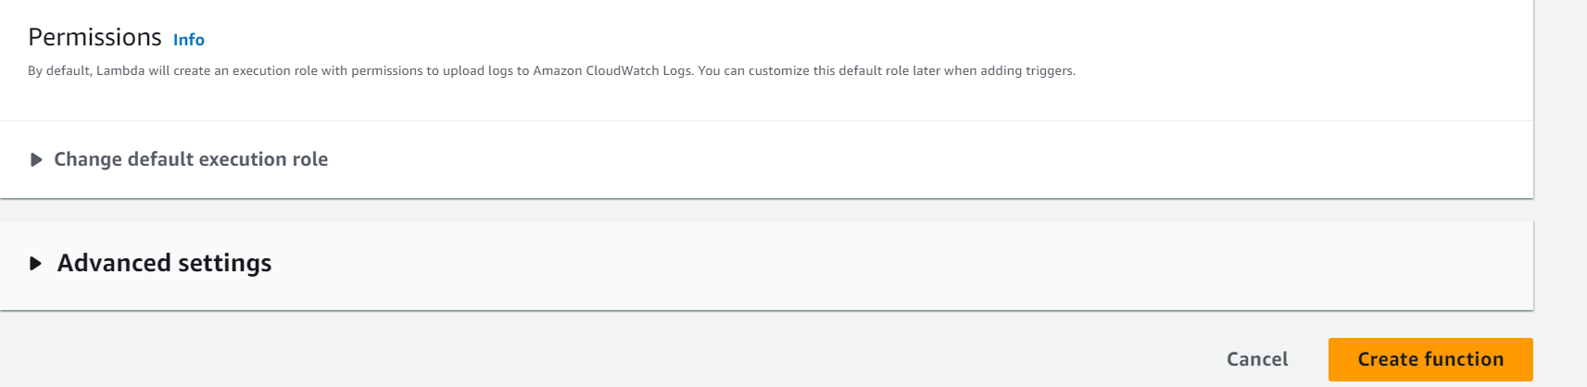

Slide 9
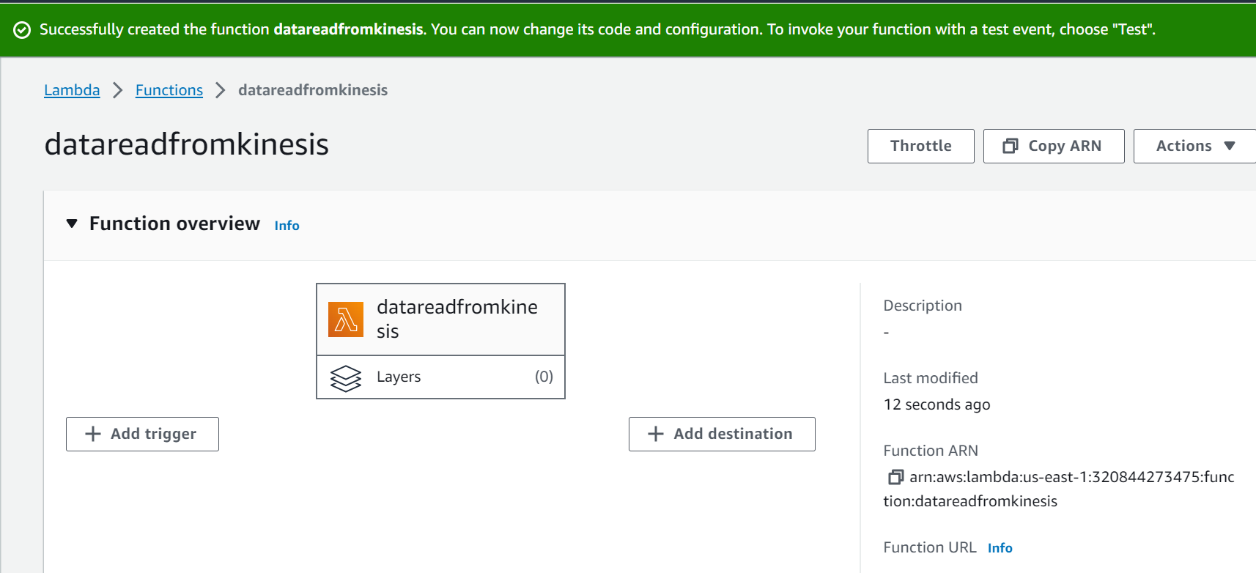
Lambda Function Created

Slide 10
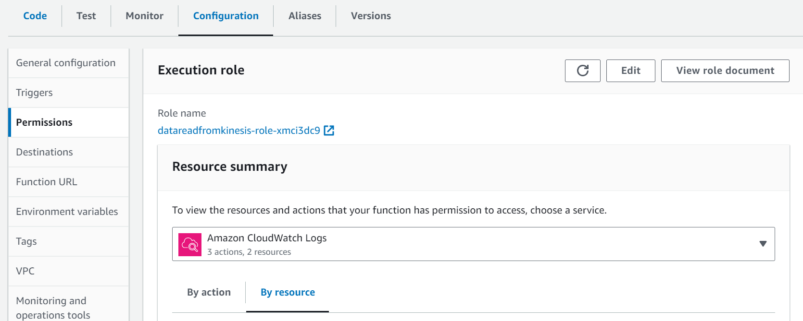
Creating Lambdaexcution role + kinesis permissions
Goto Lambda function and click on configuration and click on permissions
Here role is already created with lambda function creation , now will provide the permissions. Click on Role name datareadfromkinesis-role-xmci3dc9

Slide 11
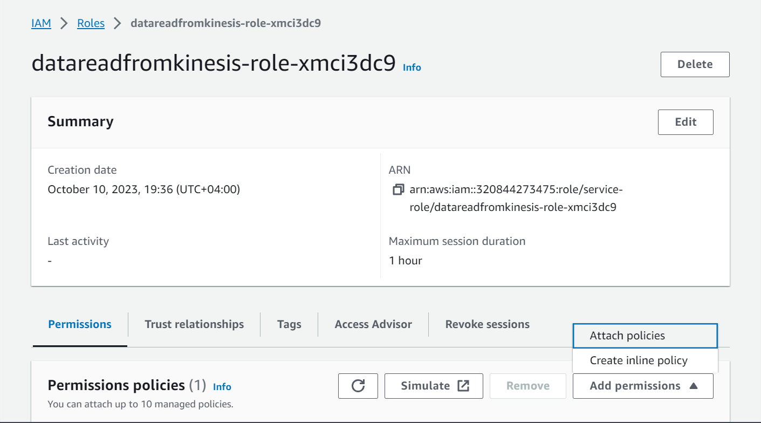
Click on Add permissions and click on Attach policies

Slide 12
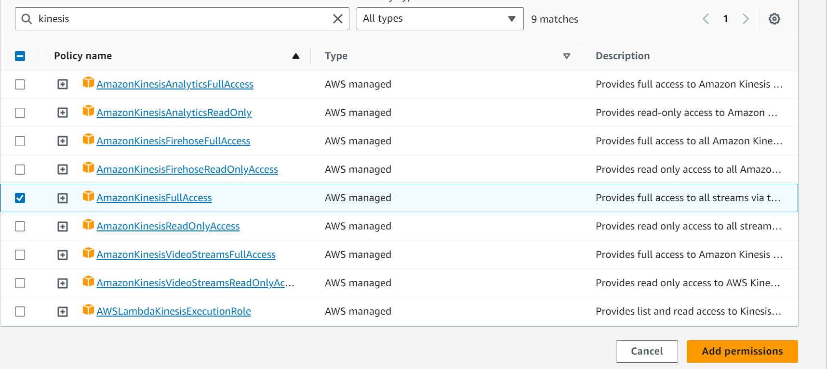
Search for Kinesis and add AmazonKinesisFullAccess policy and click on Add permissions

Slide 13
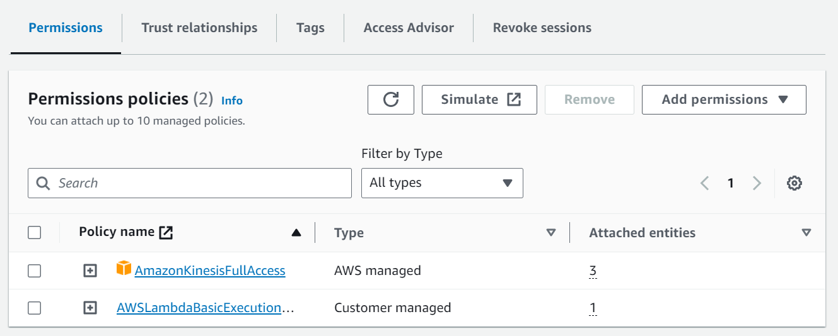
Policy added

Slide 14
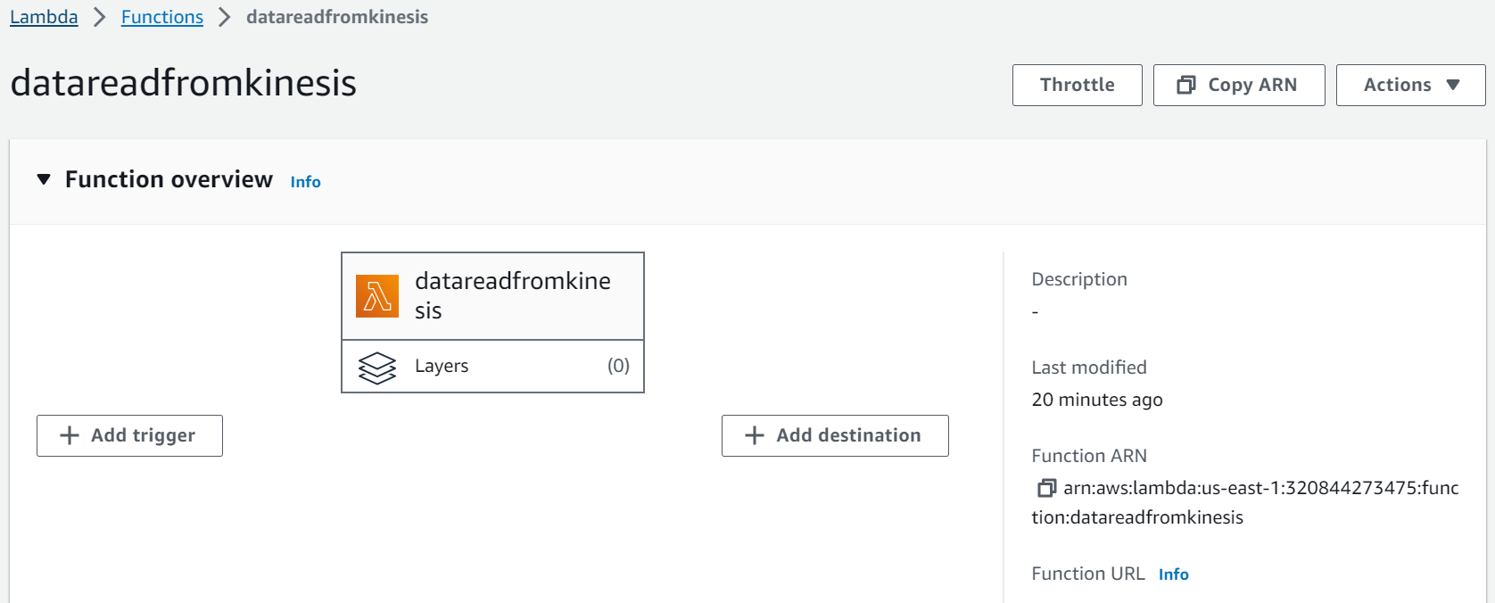
Adding Kinesis trigger in Lambda function for integration and to read data from kinesis data stream
Goto Lambda Function and click on Add trigger

Slide 15
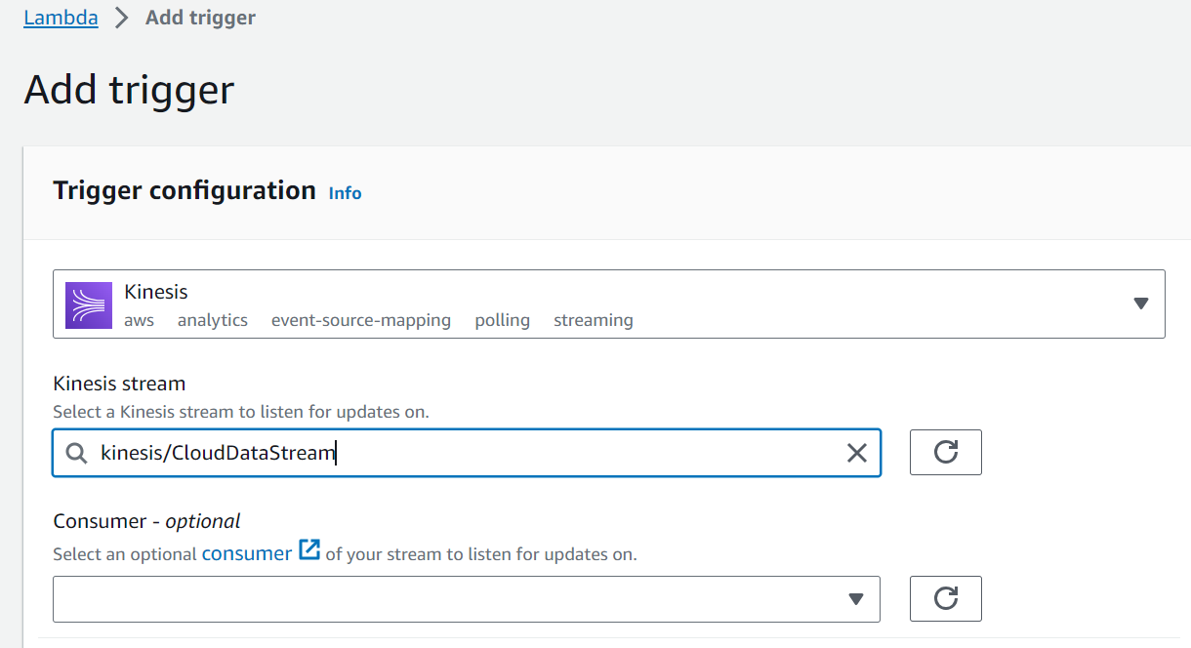
Choose Kinesis and choose Kinesis stream – CloudDataStream

Slide 16
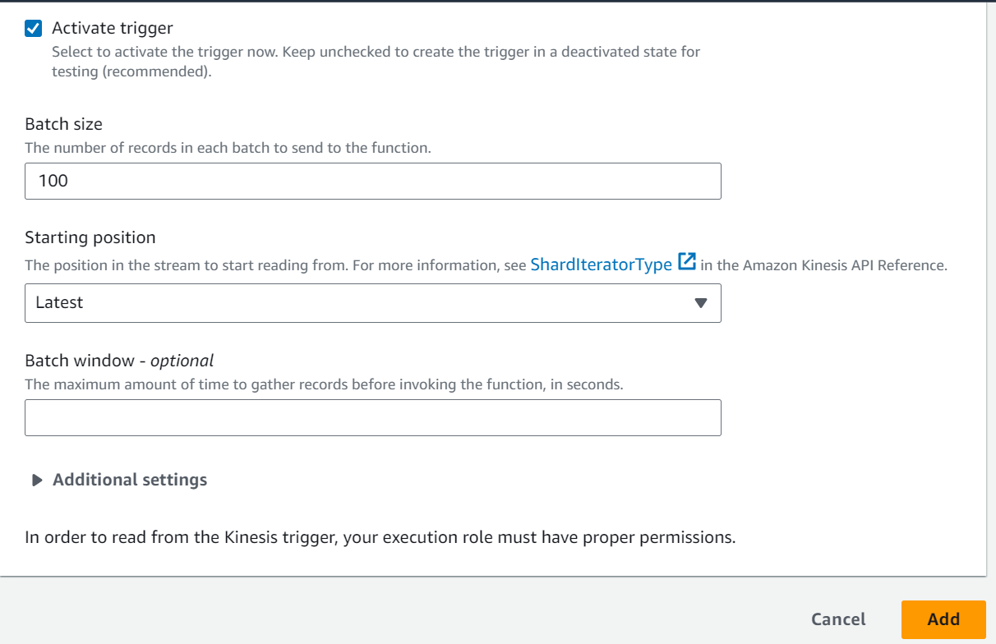
other settings choose by default and click on Add

Slide 17
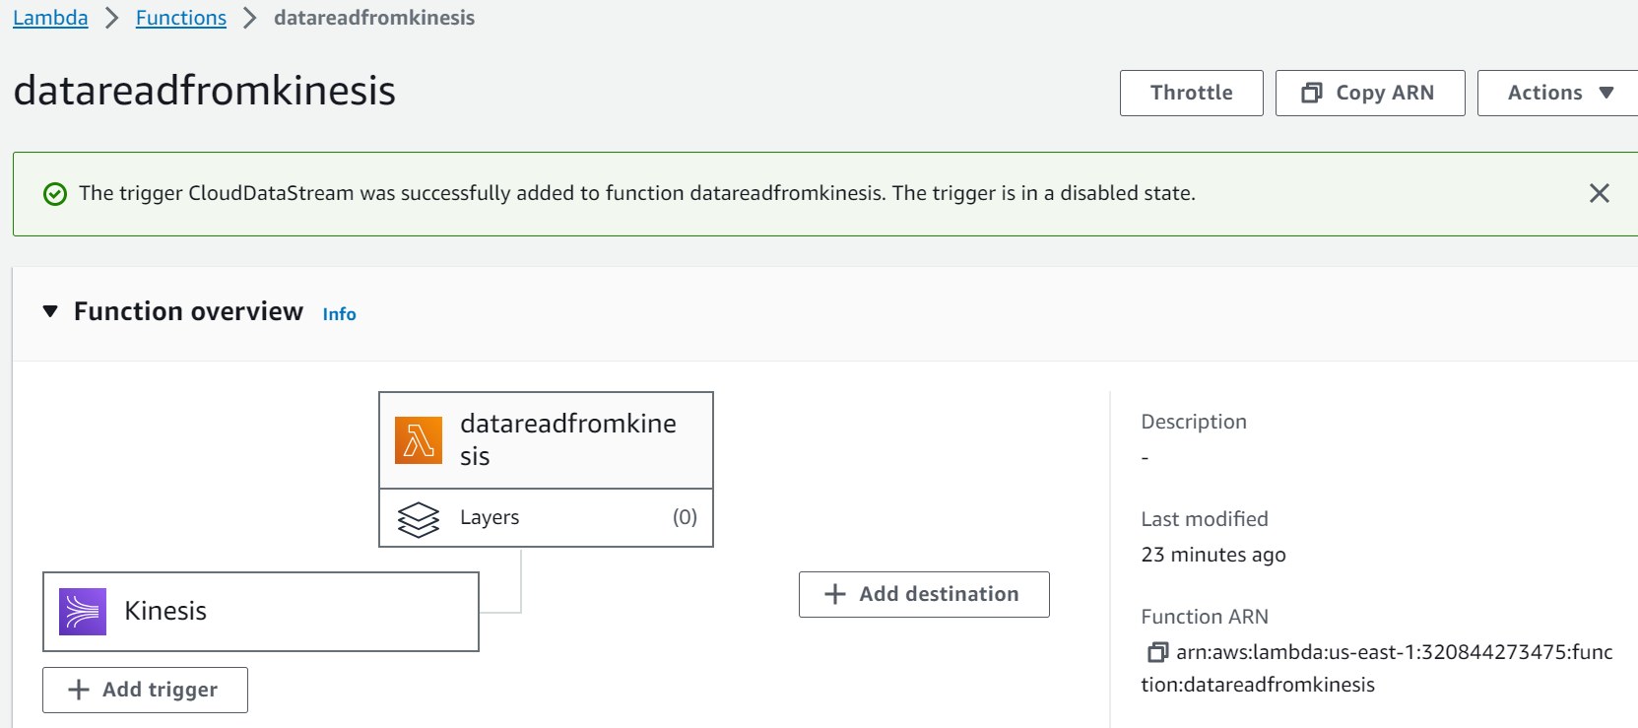
Kinesis trigger added with my lambda function

Slide 18
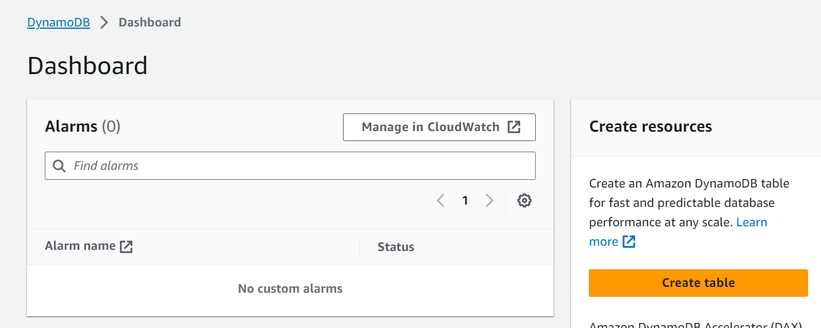
Creating AWS DynamoDB database
Click on Create table

Slide 19
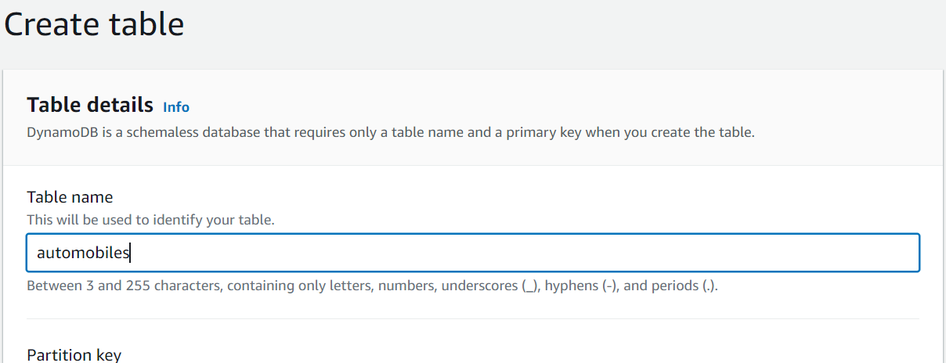
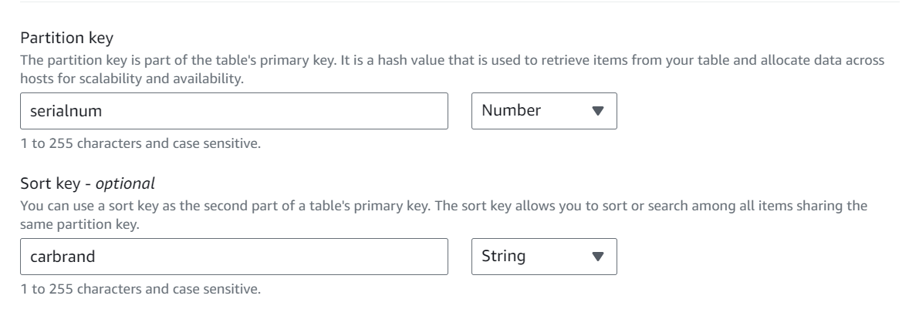
Table name automobiles
My Partition Key is serialnum with Number

Slide 20
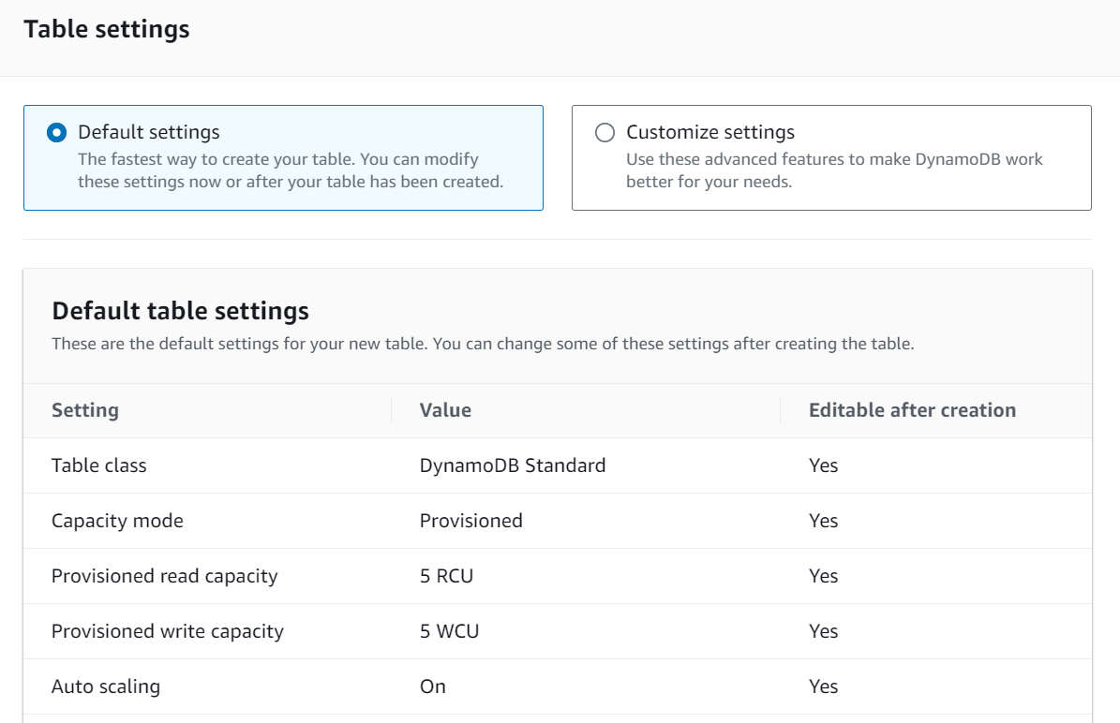
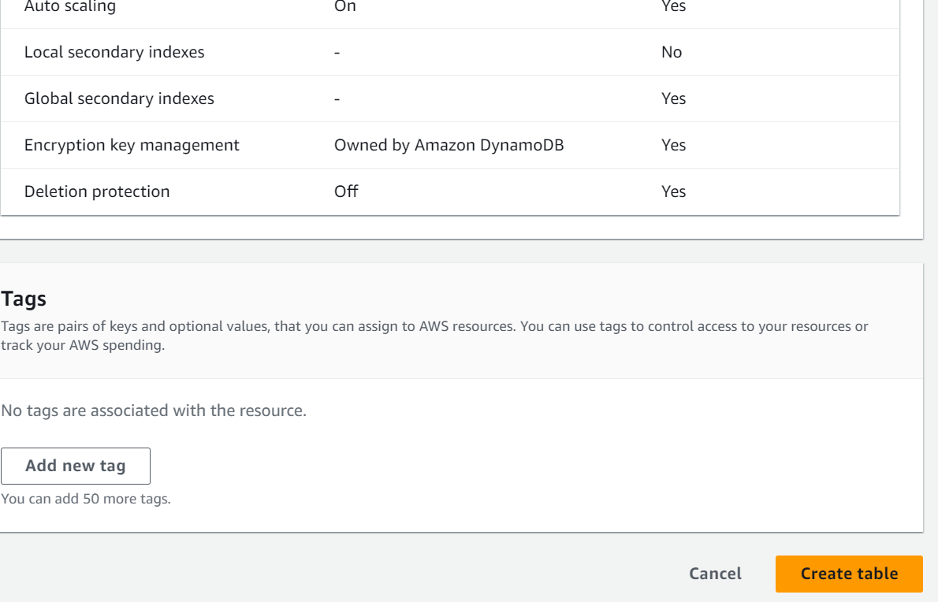
Click on create table

Slide 21
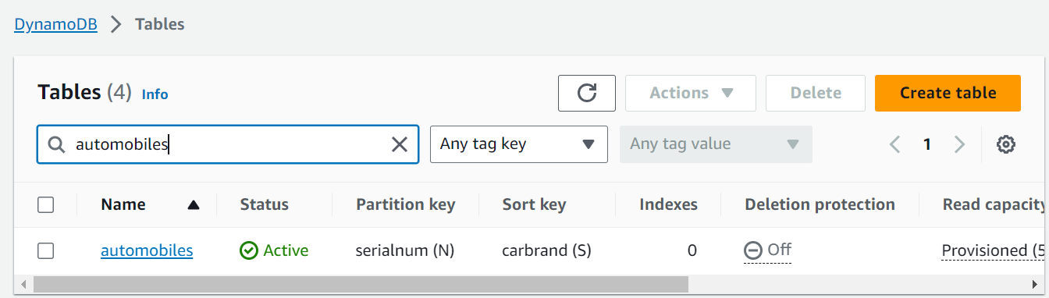
DynamoDB tables created with automobiles and partition key serialnum

Slide 22
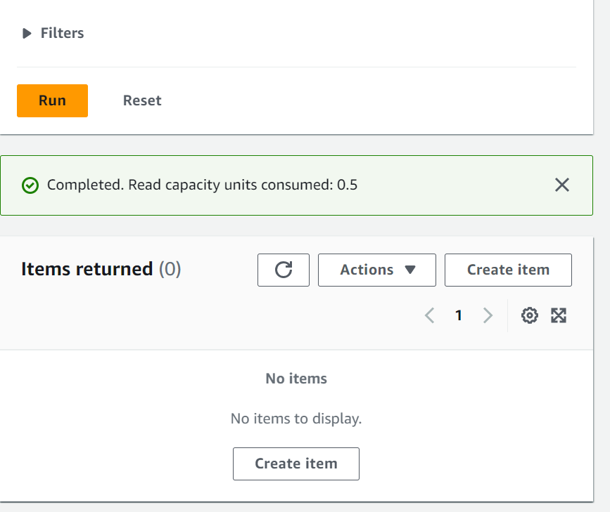
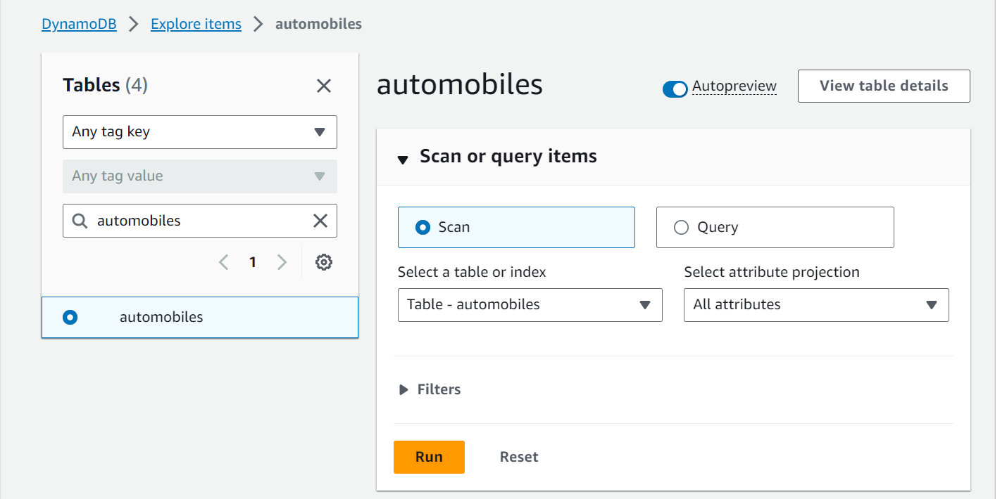
Click on explore and click on automobiles table to check record
Currently no data in my automobiles tables

Slide 23
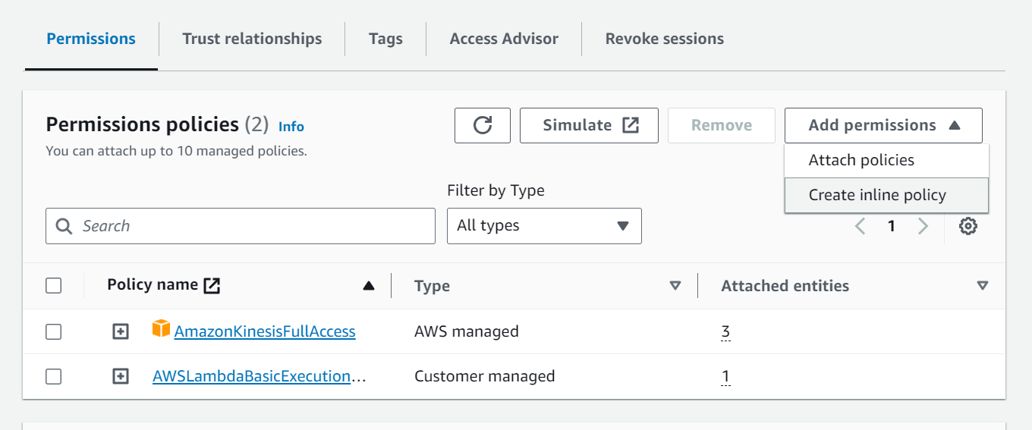
Adding policy write data into my DynamoDB tables in my lambda function role
Click on attach policies and search for AmazonDynamoDBFullAccess policy and click on add policy

Slide 24
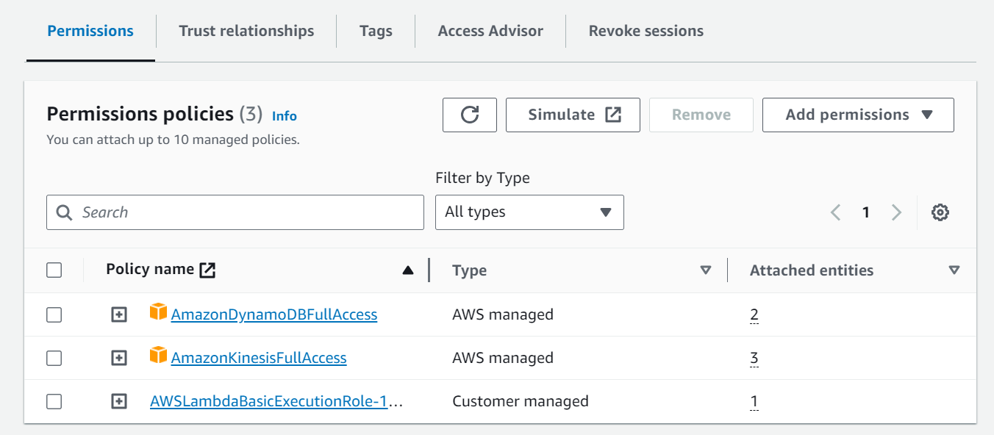
Policy AmazonDynamoDBFullAccess added.

Slide 25
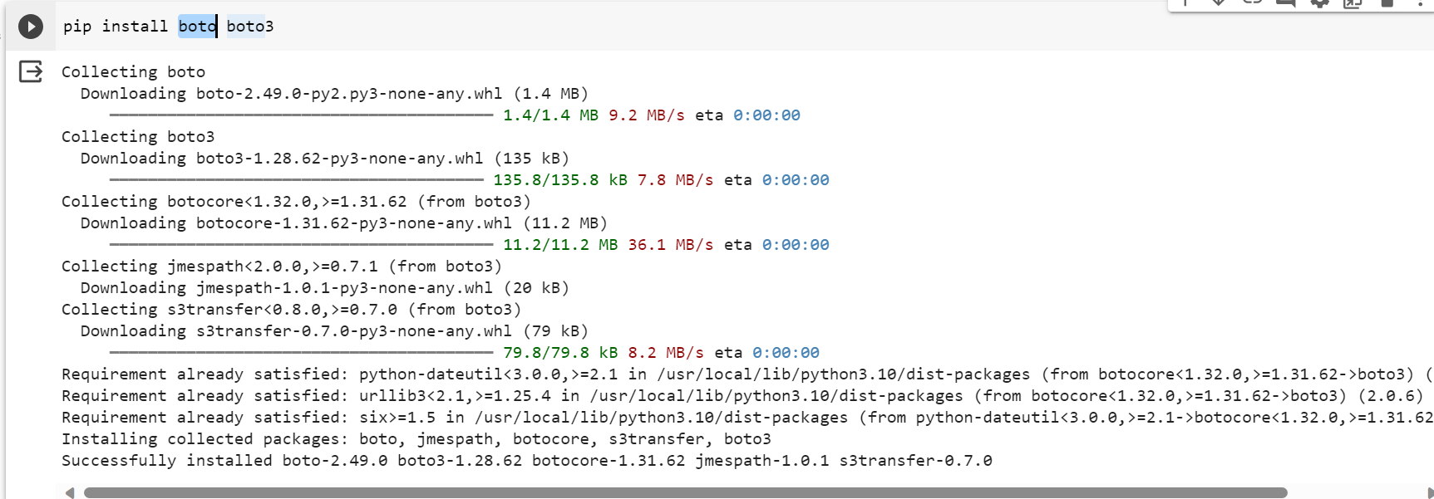
Using Google Colab to generate data stream code and sending to my Kinesis CloudDatatStream
Installing boto and boto3 libraries on colab

Slide 26
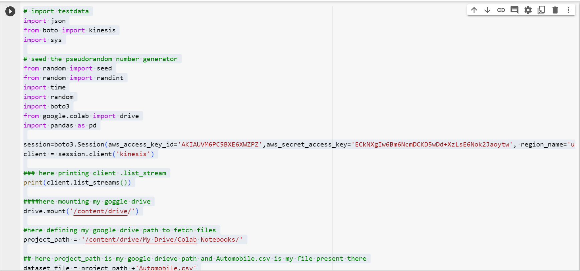
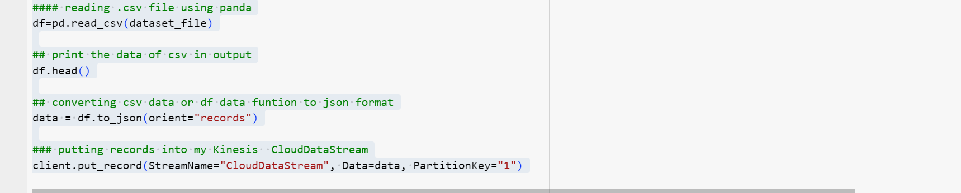
Fetching data from automobile.csv and converting to json format and sending to my Kinesis CloudDataStream
Sending Data to my Kinesis CloudDataStream

Slide 27
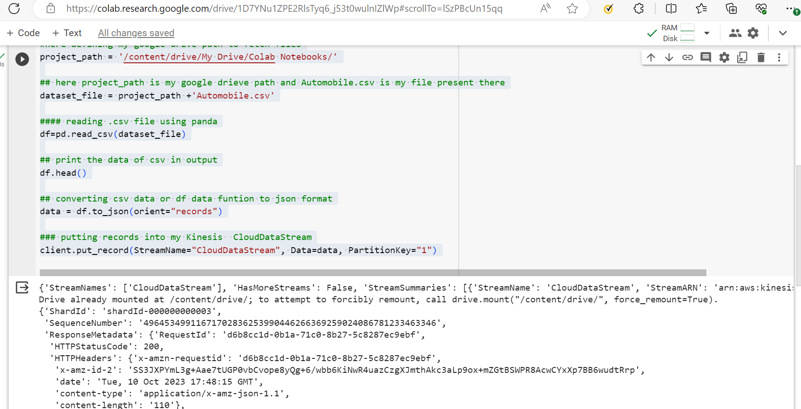
Data sent to my Kinesis CloudDataStream

Slide 28
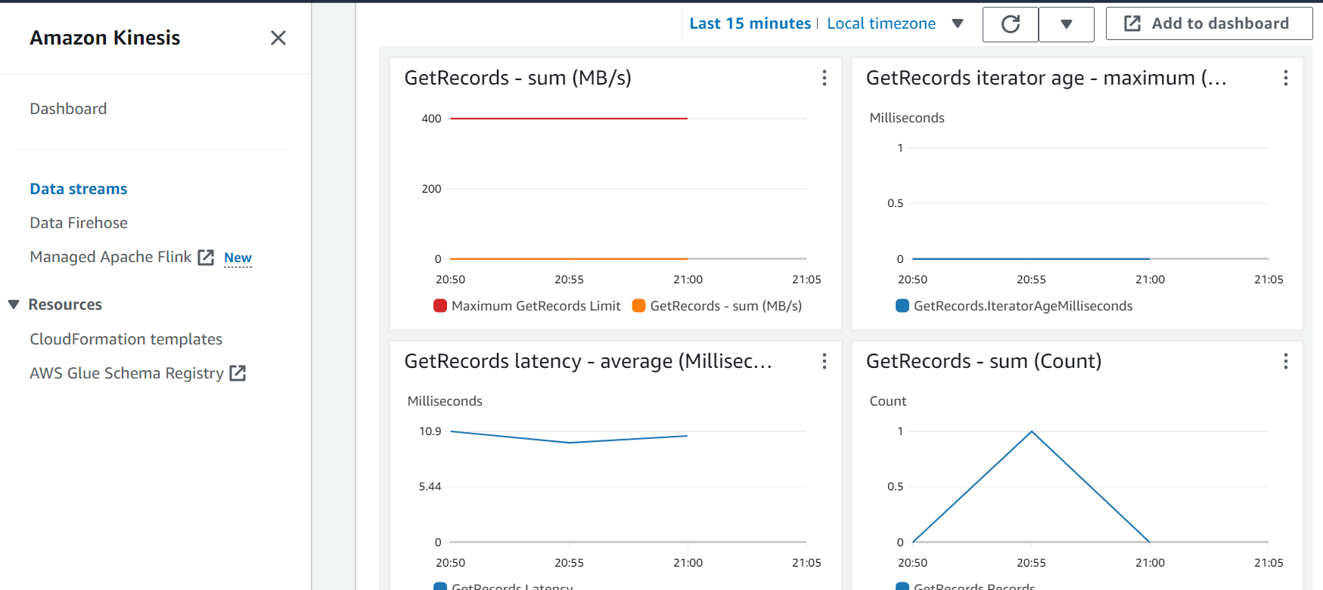
Monitoring data reached to my Kinesis CloudDataStream
Data showing on my CloudDataStream monitoring

Slide 29
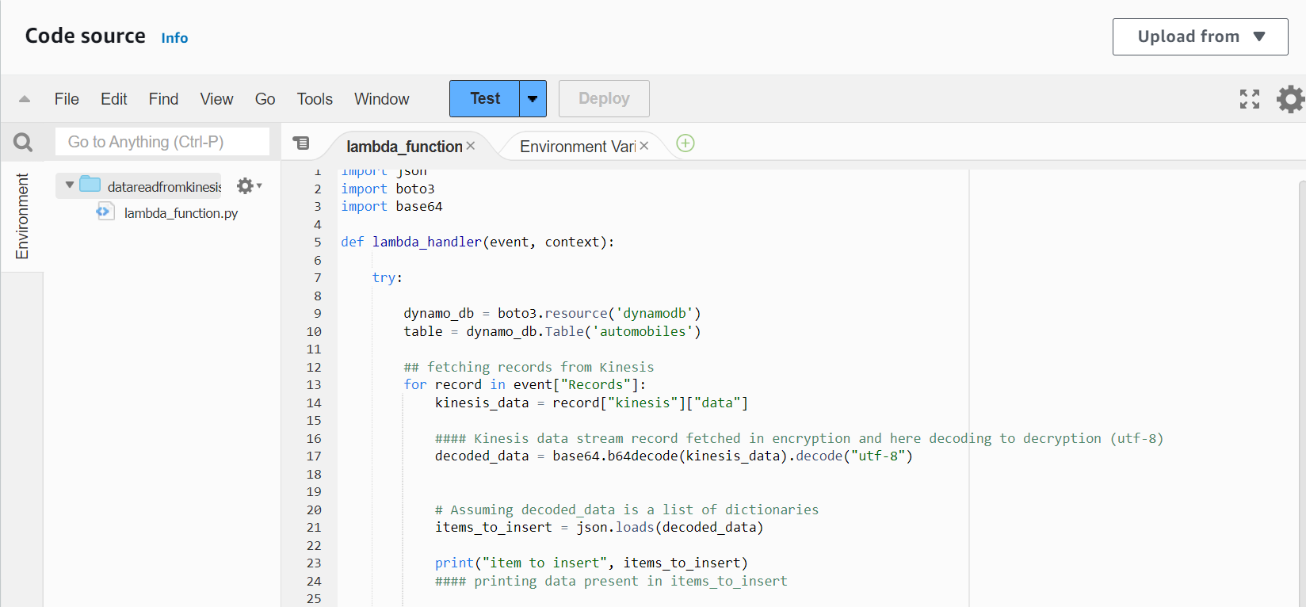
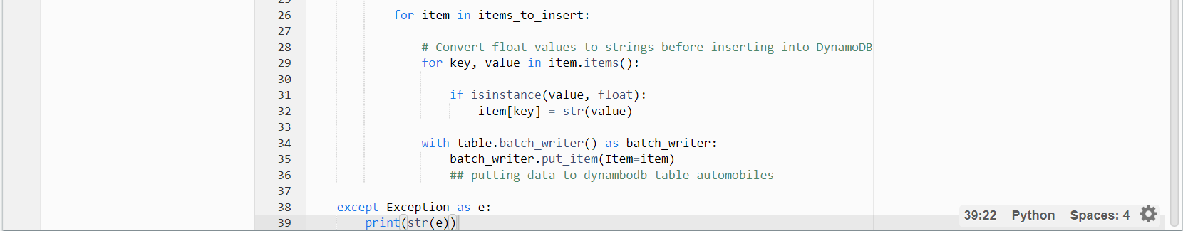
Fetching Kinesis CloudDataStream data via my Lambda function code and storing the same data in my DynamoDB automobiles table

Slide 30
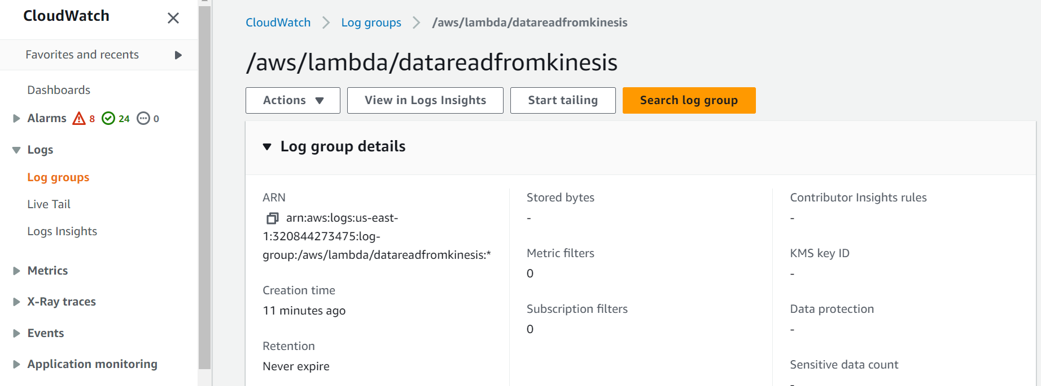
Using CloudWatch Lambda logs to Monitor data reached to my CloudDataStream
Click on CloudWatch and click on log group and click on datareadfromkinesis folder, here my logs will be written

Slide 31
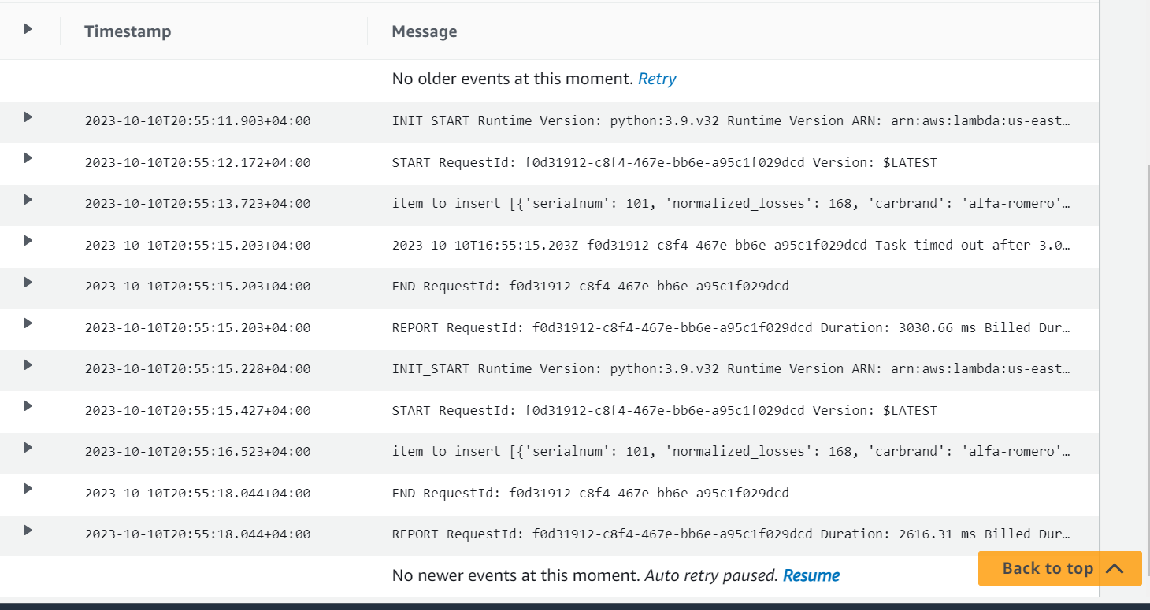
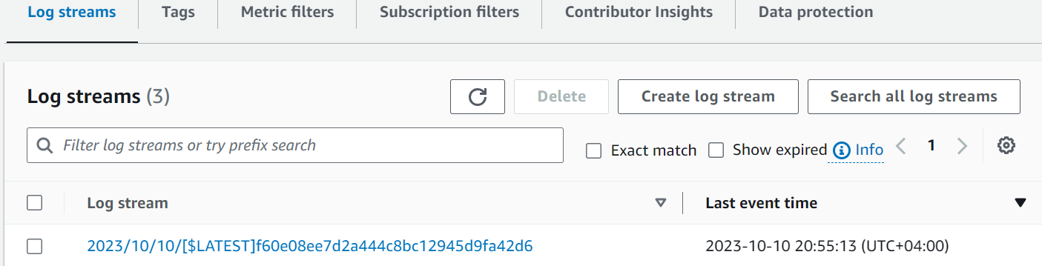
new folder created with current time click on it
Its showing my lambda function start the fetch request and inserted the data into my DynamoDB tables.

Slide 32
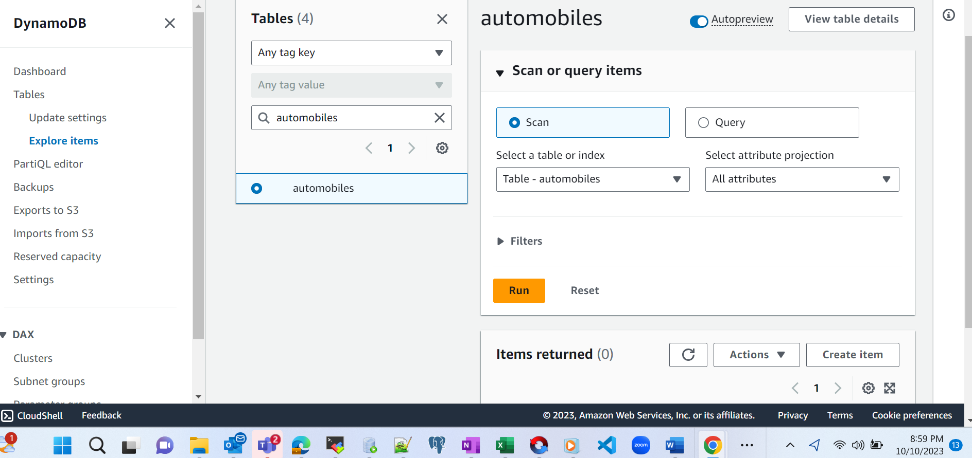
Performing a scan operation on my DynamoDb tables
Checking data inserted to my DynamoDB automobiles table

Slide 33
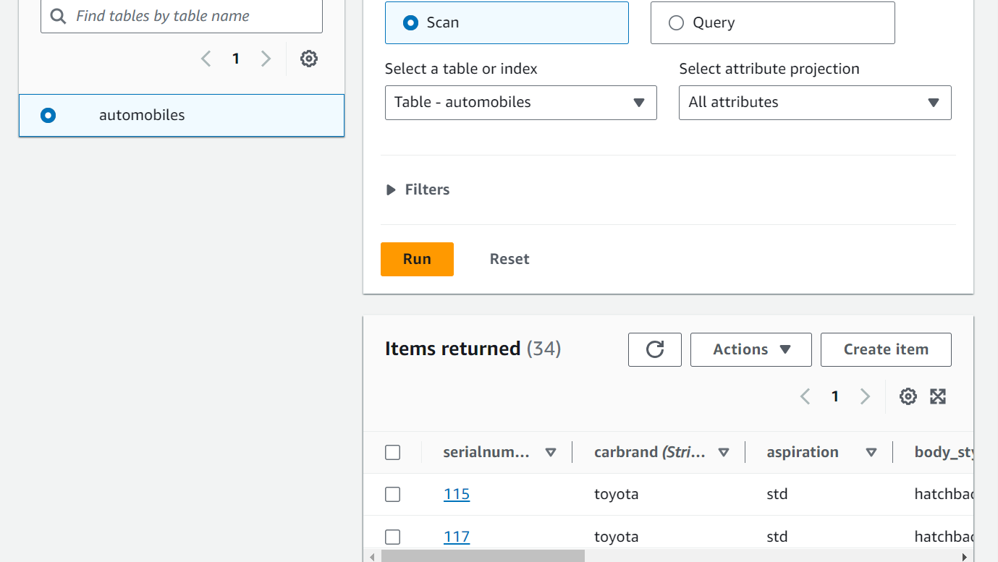
Output Screenshot
Select Scan and click on Run
After Scan on my DynamoDB automobiles table , 34 records has been inserted from Kinesis CloudDataStram

